Slide 1

CSC364-Software Engineering Week-4 Lecture-7 Semester-# Fall 2018
Prepared by:
M. Sajid Farooq

Slide 2
Requirement Engineering

Slide 3
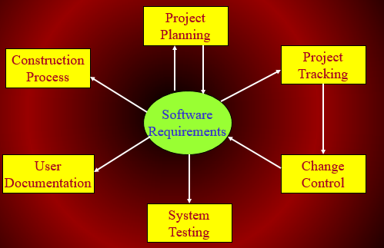
Role of Requirements

Slide 4
Software Requirements – Definition - IEEE
A condition or capability needed by user to solve a problem or achieve an objective.
A condition or capability that must be met or possessed by a system or system component to satisfy a contract, standard, specification, or other formally imposed document.
A documented representation of a condition or capability as in 1 or 2.

Slide 5
Software Requirements – Definition - Jones
The statement of needs by a user that triggers the development of a program or system - Jones 1994

Slide 6
Software Requirements - Definition
Requirements are ... A specification of what should be implemented. They are descriptions of how the system should behave, or of a system property or attribute. They may be a constraint on the development process of the system. - Sommerville 1997

Slide 7
Importance of the Software Requirement Process
The hardest single part of building a software system is deciding precisely what to build. No other part of the conceptual work is as difficult as establishing the detailed technical requirements, including all the interfaces to people, to machines, and to other software systems. No other part of the work so cripples the system if done wrong. No other part is more difficult to rectify later.
Fred Brooks - No Silver Bullet: Essence and Accidents of Software Engineering, 1987.

Slide 8
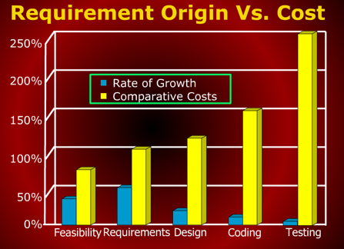
Requirement Origin Vs. Cost

Slide 9
Levels of Requirements
Business Requirements
User Requirements
Functional Requirements
Non-Functional Requirements

Slide 10
Functional and Non-functional Requirements

Slide 11
Requirement Statement versus Requirement Specification

Slide 12
Some Risks from Inadequate Requirement Process

Slide 13
Some Risks From Inadequate Requirement Process
Insufficient user involvement leads to unacceptable products.
Creeping user requirements contribute to overruns and degrade product quality.
Ambiguous requirements lead to ill-spent time and rework.
Gold-plating by developers and users adds unnecessary features.
Minimal specifications lead to missing key requirements.
Overlooking the needs of certain user classes (stake holders) leads to dissatisfied customers.
Incompletely defined requirements make accurate project planning and tracking impossible.

Slide 14
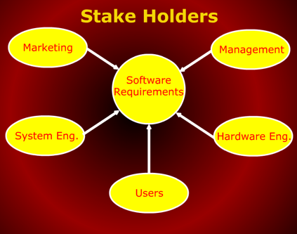
Stack Holders

Slide 15
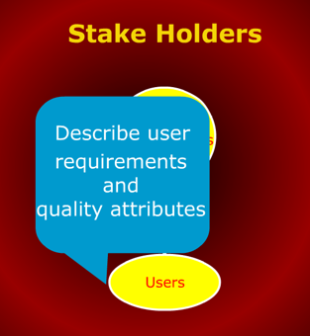
Stake Holders

Slide 16
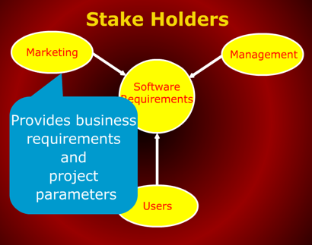
Stake Holders

Slide 17
Stake Holders

Slide 18
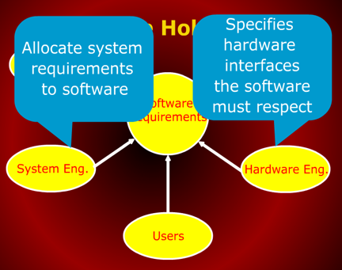
Stake Holders

Slide 19
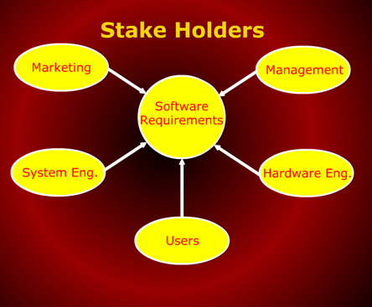
Stake Holders

Slide 20
The End

Slide 21
Q & A

Slide 22
References
These lecture notes were taken from following source:

